Slide 1
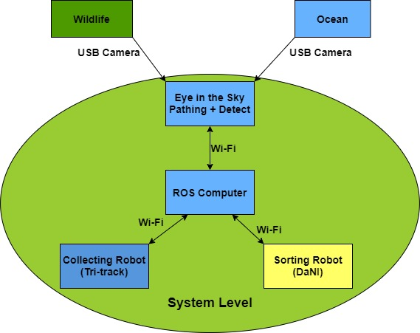

19WSD001 Team Project – E.A.R.T.H
09/01/2020
Objectives/ Aim (What?)
Aim: Accurately identify and sort rubbish from a beach,
leaving it in a higher standard than when arriving.
Current Objectives
Grabbing trash
Sorting trash
Intelligent path planning
Activities (How)
Budget statement
Remaining Budget: £ 131.92
Spent: £ 68.08
Budget Plan please see link: https://bit.ly/2ZYQfXB
Actions | State
Independent control of robot vehicles via Xbox Controller
Sorting – Object recognition Sorting – Grabbing object Sorting – Bin detection Sorting – Placing in appropriate bin
Integration between systems using ROS
Pathing – map of environment Pathing – decision of route to follow
Wildlife detection – Crabs Wildlife detection – Seagulls
Telemetry – UI Design Telemetry – Data acquisition Telemetry – Camera feed
Mission phase completion
Phase | Completion
Enter and navigate the beach area using intelligent route finding​
Identify recycling bins from optically coded sensors (at least 3 different types)
Identify and sort different types of rubbish
Identify and characterize different crab types and the routes taken​
Actively avoid interfering with the crabs​
Identify and alert operators about other wildlife​
Identify waterline and actively avoid or mitigate against the incoming tide
Stakeholders (Who?)
The company staff, shareholders, suppliers, etc
System operators
People on the beach
Wildlife on the beach
Beach Management
Recycling businesses
Strategy/ Plan (Why?)
Consult with PST on major steps involving trash pick up when sorting
Capitalize on reduced contact time between before Semester 2 starts
Integrate different implemented modules of the system using ROS
Minimize unnecessary complexity to the system while maintaining robustness
Currently working on: Finishing and integrating systems
Target: Level 3 – Conditional Automation
Key issues and risks
Grabbing objects and placing them in appropriate bin
Unsure how waterline will be shown on the ground
Integration
Hardware failure as viva approaches
Team information
E.A.R.T.H Github:
https://github.com/orgs/lboroWMEME-19WSD001/teams/e-a-r-t-h
E-portfolio:
https://teamearth1.wordpress.com/
Programme
Semester 1 End
Easter
Gateway 1 (S1W4)
Gateway 2 (S1W12)
Gateway 3 (S2W7)
VIVA (S2W10)
Key
Completed
In progress
Not Started
Key
Notes:
A version of this is compulsory at each gateway meeting and optional for PST meetings.
In terms of sizing, this should be legible printed on A3, but will probably be viewed on screen. Minimum font size =12
Diagram in the middle should be a top level systems diagram.
The plan will change as the project progresses – that is ok and expected.

